Slide 1
Napredni javascrip
Metode nad nizovima

Slide 2
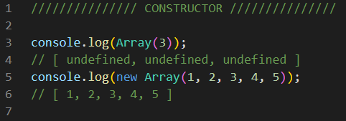
CONSTRUCTOR

Slide 3
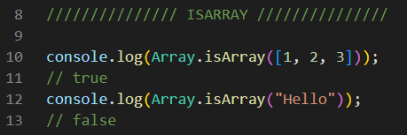
ISARRAY

Slide 4
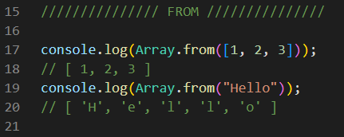
FROM

Slide 5
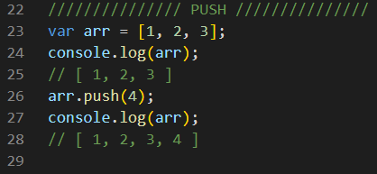
PUSH

Slide 6
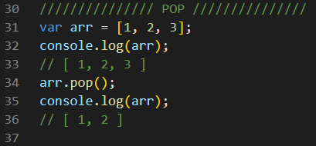
POP

Slide 7
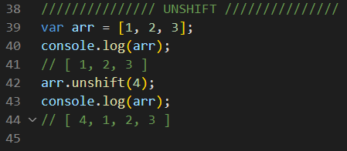
UNSHIFT

Slide 8
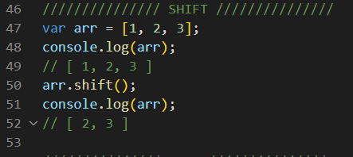
SHIFT

Slide 9
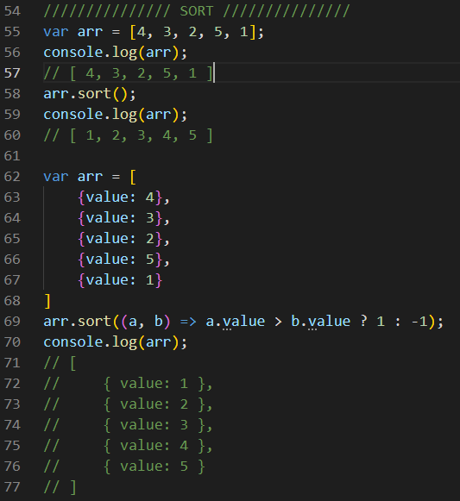
SORT

Slide 10
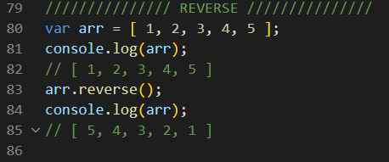
REVERSE

Slide 11

REDUCE

Slide 12

MAP

Slide 13

FILTER

Slide 14

FOREACH

Slide 15

JOIN

Slide 16
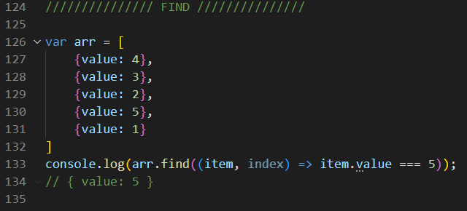
FIND

Slide 17
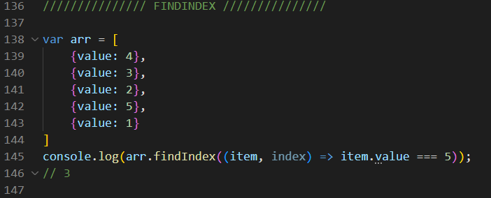
FINDINDEX

Slide 18

EVERY

Slide 19

SOME

